Slide 1
Topic: Algebra
EQ: What are the key parts of an equation and how do we collect like terms?
Mrs. McLeod

Slide 2
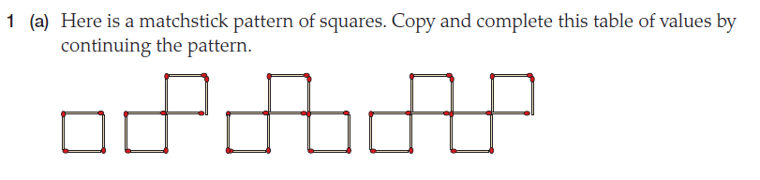
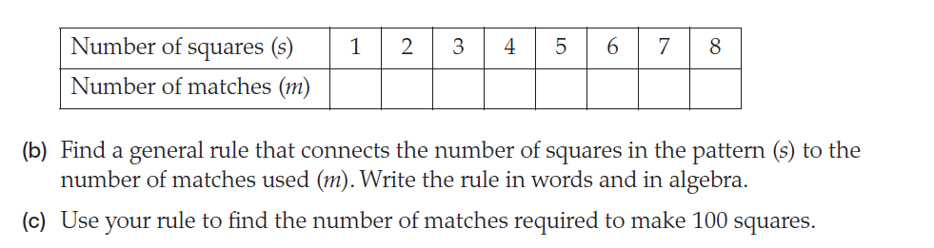

Slide 3
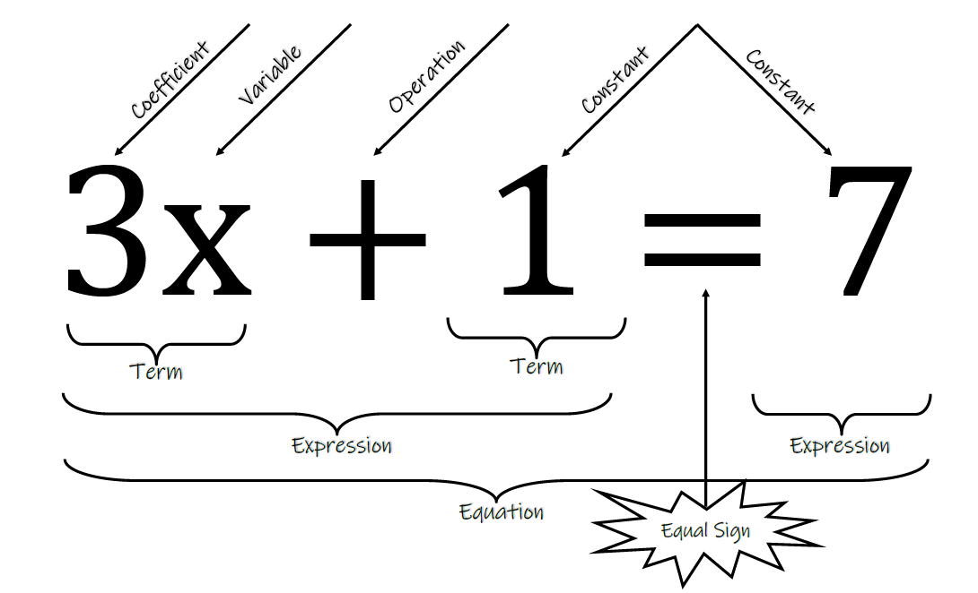
24
7
30
Topic:
Date
Algebra
EQ:
What are the key parts of a equation and how do we collect like terms?
Add to glossary:
Coefficient
Variable
Operation
Constant
Term
Expression
Equation
Parts of an Equation
Notes:
Could print out the fill in the blank graphic organizer for them to glue in

Slide 4


24
7
30
Topic:
Date
Algebra
EQ:
What are the key parts of an equation and how do we collect like terms?
QuickWrite! 60 seconds what do you think this could mean?
What is a like term?
Terms that have the same variables to the same powers (we will not be working with powers in year 7 though)
Like terms can be simplified by collecting them together and writing the variable and a coefficient
We’ve got 2 lots of “m” number of blocks
m+m is one way we could write this
But these are LIKE TERMS so we can combine with a coefficient of 2
2m
m
m

Slide 5
Collecting Like Terms Practice
Ask yourself:
Are they like terms?
Do they have the exact same variable?
I do
1) b+b+b
2) 2a + 4a
3) 10c-4c -2e
We do
1) c+c+c+c+c
2) e + 4e
3) 2a+a+b
You do
1)5f + 2f
2) 3a – a
3) 6h + 2h +4r
Worksheet – Collecting Like Terms 2
Notes:
Worksheet – Collecting Like Terms 2

Slide 6
24
7
30
Topic:
Date
Algebra
EQ:
What are the key parts of an equation and how do we collect like terms?
Mathematicians simplify without multiplication symbols AND write variables in alphabetical order
How do we simplify with multiplication or division?
3 × a × 2 =
3 × 2 × a =
6 × a =
6a
We can combine the numbers (by multiplying or dividing) to make one coefficient in front of the variable, then list the variables in alphabetical order
Ex 1.
2 × f × 4 × t =
2 × 4 × f × t =
8 × f × t =
8ft
Ex 2.
5 × 10 × b × 2 × c =
5 × 10 × 2 × b × c =
100 × b × c =
100bc
Ex 3.
8 × m ÷ 2 =
8 ÷ 2 × m =
4 × m =
4m
Notes:
Have Sum Fun – 100 Why Shouldn’t you tell riddles while ice skating?
Go through the first 4 questions together then let them work independently

